Slide 1
Y3 Coachability
Presentation by Coachability Curriculum Team:
Kiri Evans, MS4 - Chair
Bukola Ayegbusi, MS4 - Manager
Peyton Keller, MS4 - Manager
Brix Clayton, MS4 - Manager
Notes:
Introduce yourself and your team. Thank attendees for their attention. Explain that the purpose of this session is to introduce coachability concepts particularly relevant to Year 3, in particular, feedback.

Slide 2
OBJECTIVES
Review Y2 Sessions
Recommend tools for success - Y3 Student Handbook
Define upward feedback
Explore the difficulties of bi-directional feedback
Discuss strategies to elicit the BEST feedback from your preceptors & succeed during clerkships

Slide 3
Y2 Coachability Recap
Feedback
Clarify expectations, set time for feedback, ask for specific feedback
Conflict Resolution and Resiliency
Take time for yourself- it is okay to take breaks, reach out for help when you need it
Listen to understand, communicate, compromise
Patient Coachability
Educate your patients so they can make informed decisions, spend time with your patients and listen, remove yourself from hostile situations
Notes:
We will review all of our sessions from Y2.
First session was about feedback with the drawing activities. We will review other tips for feedback later in this presentation
Second session was on conflict resolution and resiliency. You filled out the Burnout survey and discussed some cases of conflict. We reminded you take set specific times for guilt-free breaks. We also discussed conflict resolution. Listen to understand and start with curiosity. Some may deal with these situations through anger, detachment, avoidance, etc. Therefore be aware of your tone and choice of word. Brainstorm possible resolutions. Choose the best resolution or compromise
Third session was patient coachability. We role-played different patient scenarios. Our job is to educate patients so that they can make an informed decision about their own healthcare (not to argue, judge, or force their hands). We want to understand the patient as a person and how their illness is affecting them beyond the medical realm. Recognize when you are in a hostile situation as opposed to a situation of misunderstanding and how to remove yourself from this situation.

Slide 4
Y3 STUDENT TO STUDENT HANDBOOK
Specific advice for success in each clerkship
Suggested goals and learning issues
Tips & tricks we wish we had known

Slide 5
WHAT IS UPWARD FEEDBACK?
In a hierarchical system it is when a lower ranking member gives feedback to a higher ranking member
You will be expected to do this:
Clerkship evaluations
Preceptor evaluations
Resident evaluations
Notes:
During medical school training, you are often asked to give feedback to other students, residents, and attendings. Sometimes this feedback is in person and sometimes via online forms. This feedback is essential to all members of the team because it can improve education for future students.
Seems simple enough, but how easy is it to actually give honest, constructive feedback to members of a higher rank?

Slide 6
HOW MANY OF YOU HAVE NOT GIVEN UPWARD FEEDBACK FOR THE FOLLOWING REASONS?
Fear of retaliation and the effect this might have on your evaluations/career
Lack of recipient openness to feedback
Worry about the hurtfulness of a message
Perception that feedback is not anonymous
Notes:
How many of you think our preceptors might also struggle with these fears?
The problem with bi-directional feedback is that for the same reasons many of us do not give open/honest feedback to our preceptors, our preceptors do not give us open/honest feedback. We expect them to give us high quality feedback to help us improve, but we rarely do the same for them in return.
We have to be mindful of this when asking for feedback. Our preceptors, like us are not necessarily good at giving feedback and have many of the same fears as us. For that reason we sometimes have to be tactful in the way we ask for feedback and the way we give feedback.

Slide 7
TIPS ON GIVING UPWARD FEEDBACK
Avoid feedback that directly addresses the recipient’s personality or character traits
Be solution-oriented about negative feedback & also provide positive feedback
Be Specific
Notes:
Feedback will be more positively received if it is constructive. Think about how you like to receive feedback. People appreciate positive reinforcement.
Instead of saying “I didn’t like how I only followed the resident around for patient visits,” say “I appreciate that I got the opportunity to write my own notes, but I think I would have learned more if I had the opportunity to see a few patients on my own.”
Only offer feedback on things that can be changed. Don’t say your attending was uptight, bossy, quiet, etc.
Don’t just say everything was great. *Specify* what worked well. This will encourage your resident/attending to be more specific with you.

Slide 8
STRATEGIES TO ELICIT QUALITY FEEDBACK
Request times each week to meet and receive feedback - in addition to real time feedback
Be open and receptive to feedback when it is offered… be COACHABLE
If necessary set the stage for receiving feedback
“Sign-out” at the end of the day with your preceptor
Informal daily verbal feedback; ask about specific behaviors, skills or activities
Formal on-the-fly feedback (most likely weekly)
Notes:
At the beginning of the week or rotation, set up a time later in the week/rotation so your preceptor can prepare their thoughts and be ready to give feedback. Don’t ask for feedback when they are busy/overwhelmed. Wait for an appropriate time.
At the beginning of the rotation, state your rotation goals. They will pay close attention to these goals so they can offer valuable feedback.
Even if you aren’t expecting feedback, you will likely receive it. Always be open. Some preceptors might not offer feedback without getting asked. Be prepared to ask- that is how you will improve and impress them.
Both formal (for the purpose of course evaluation) and informal will be valuable in improving your skills. You can ask for feedback at any time.

Slide 9
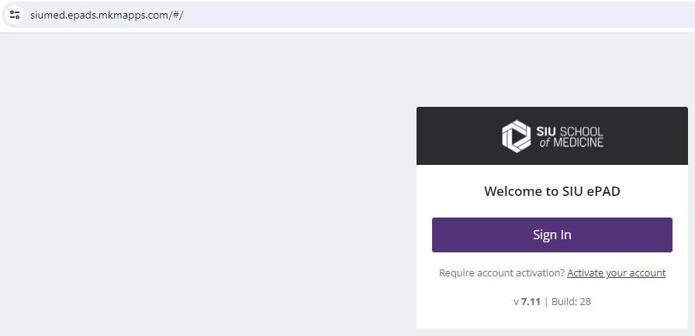
Submitting On The Flys
Step 1: Go to ePAD https://siumed.epads.mkmapps.com/#/
You can Google Search “SIUMED ePAD”

Slide 10
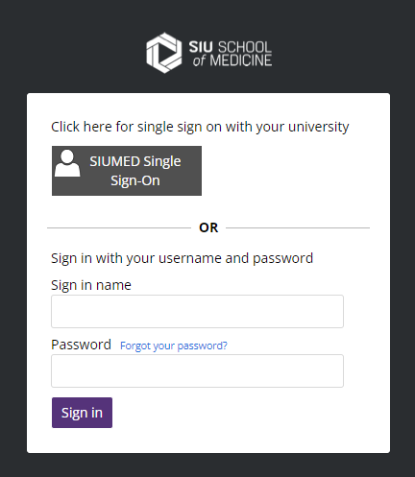
Submitting On The Flys
Step 2: Click “SIUMED Single Sign-On”
Login with your SIUMED Email & PW if prompted

Slide 11
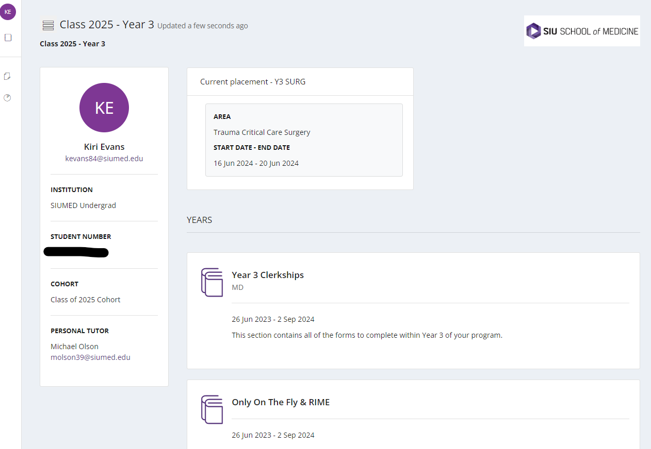
Submitting On The Flys
Step 3: Select “Only On The Fly & RIME”

Slide 12
Submitting On The Flys
Step 4: Select “Click here for forms”

Slide 13
Submitting On The Flys
Step 5: Select “Complete new” for On the Fly Clerkship

Slide 14
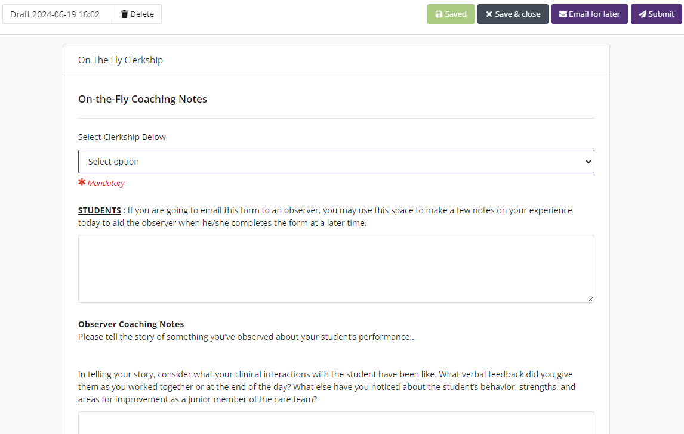
Submitting On The Flys
Step 6: Under the Select Clerkship Below use the “Select option” dropdown
Step 7: Fill out the STUDENTS section only

Slide 15
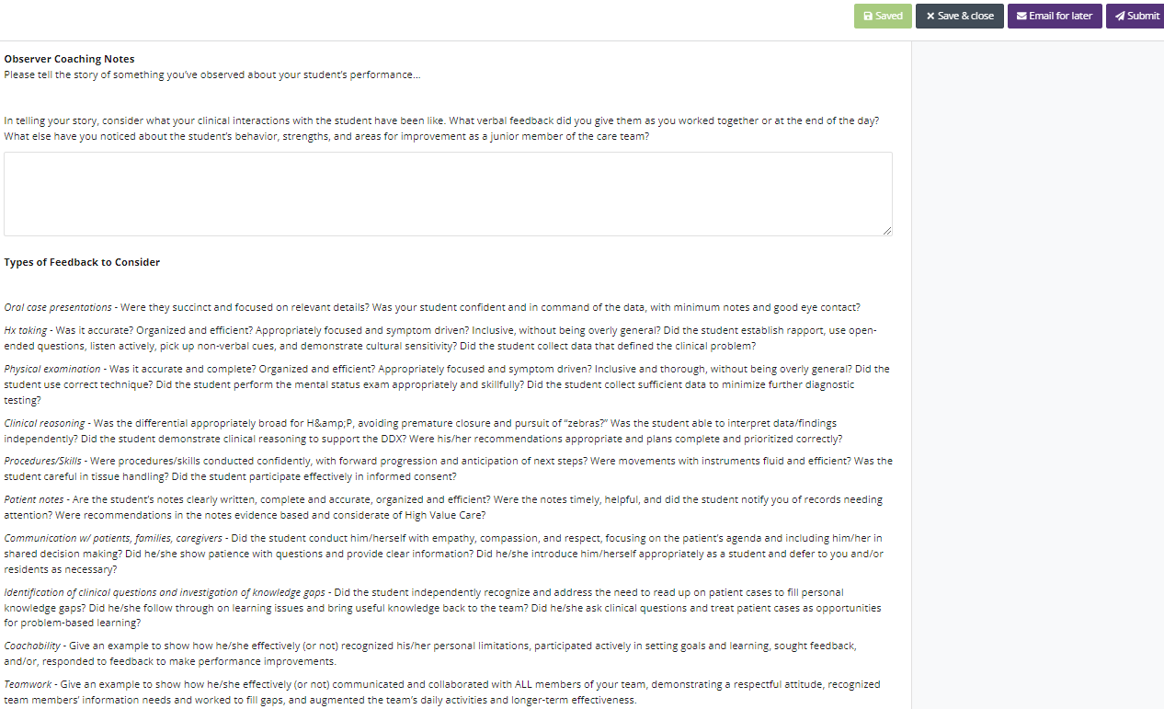
Submitting On The Flys
Step 8: Leave the “Observer Coaching Notes” Section Blank

Slide 16
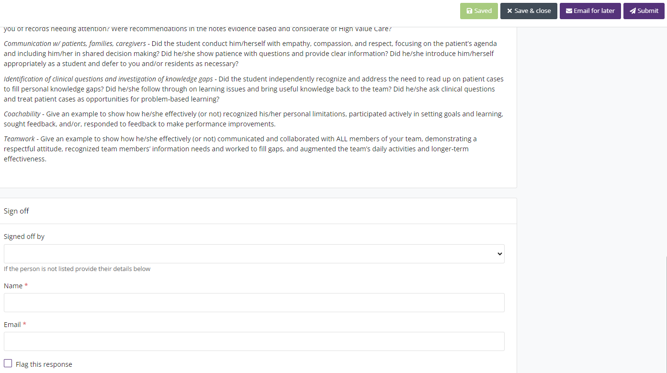
Submitting On The Flys
Step 9: Fill Out your Observer’s “Name” & “Email”
If you’ve already submitted an OTF to a certain observer, you can auto-populate their info using the dropdown under “Signed off by”
Step 10: Click “Email for later”
Although Tempting, Do NOT click “Submit”

Slide 17
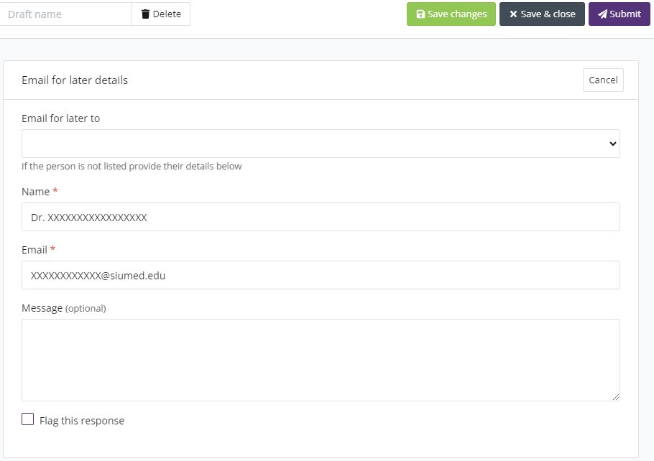
Submitting On The Flys
Step 11: Now click “Submit”
Name & Email from Step 9 Should Auto-populate

Slide 18
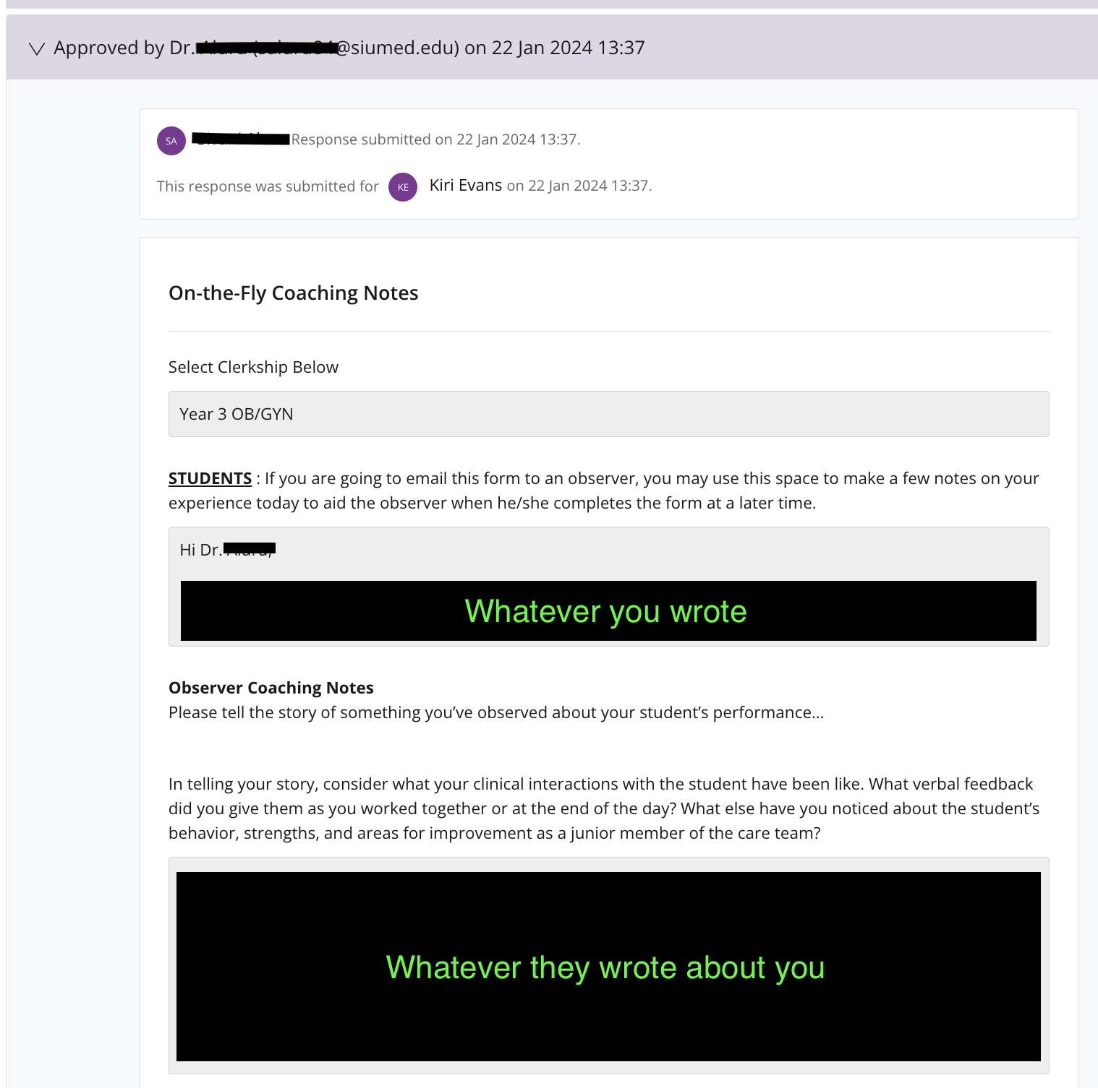
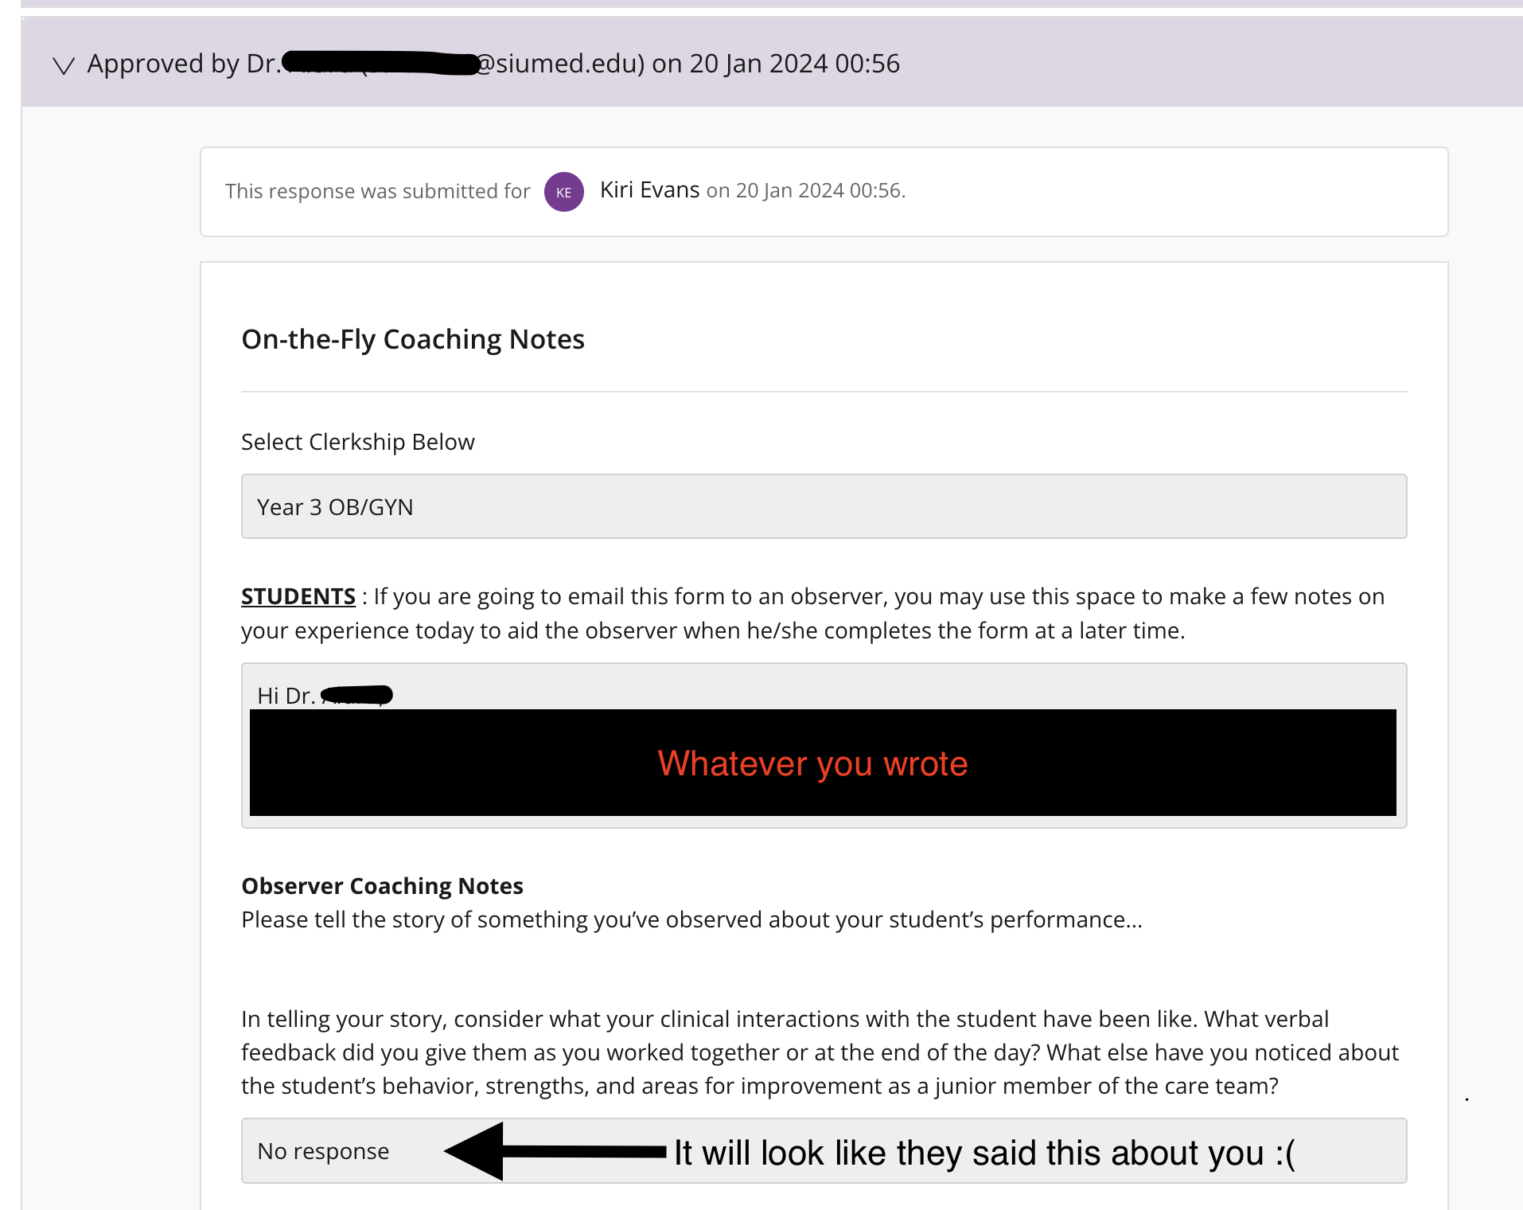
Successful (L) vs. Unsuccessful Submission (R)
Selecting the “On The Fly Clerkship” dropdown as seen on Step 5, will look something like this:

Slide 19
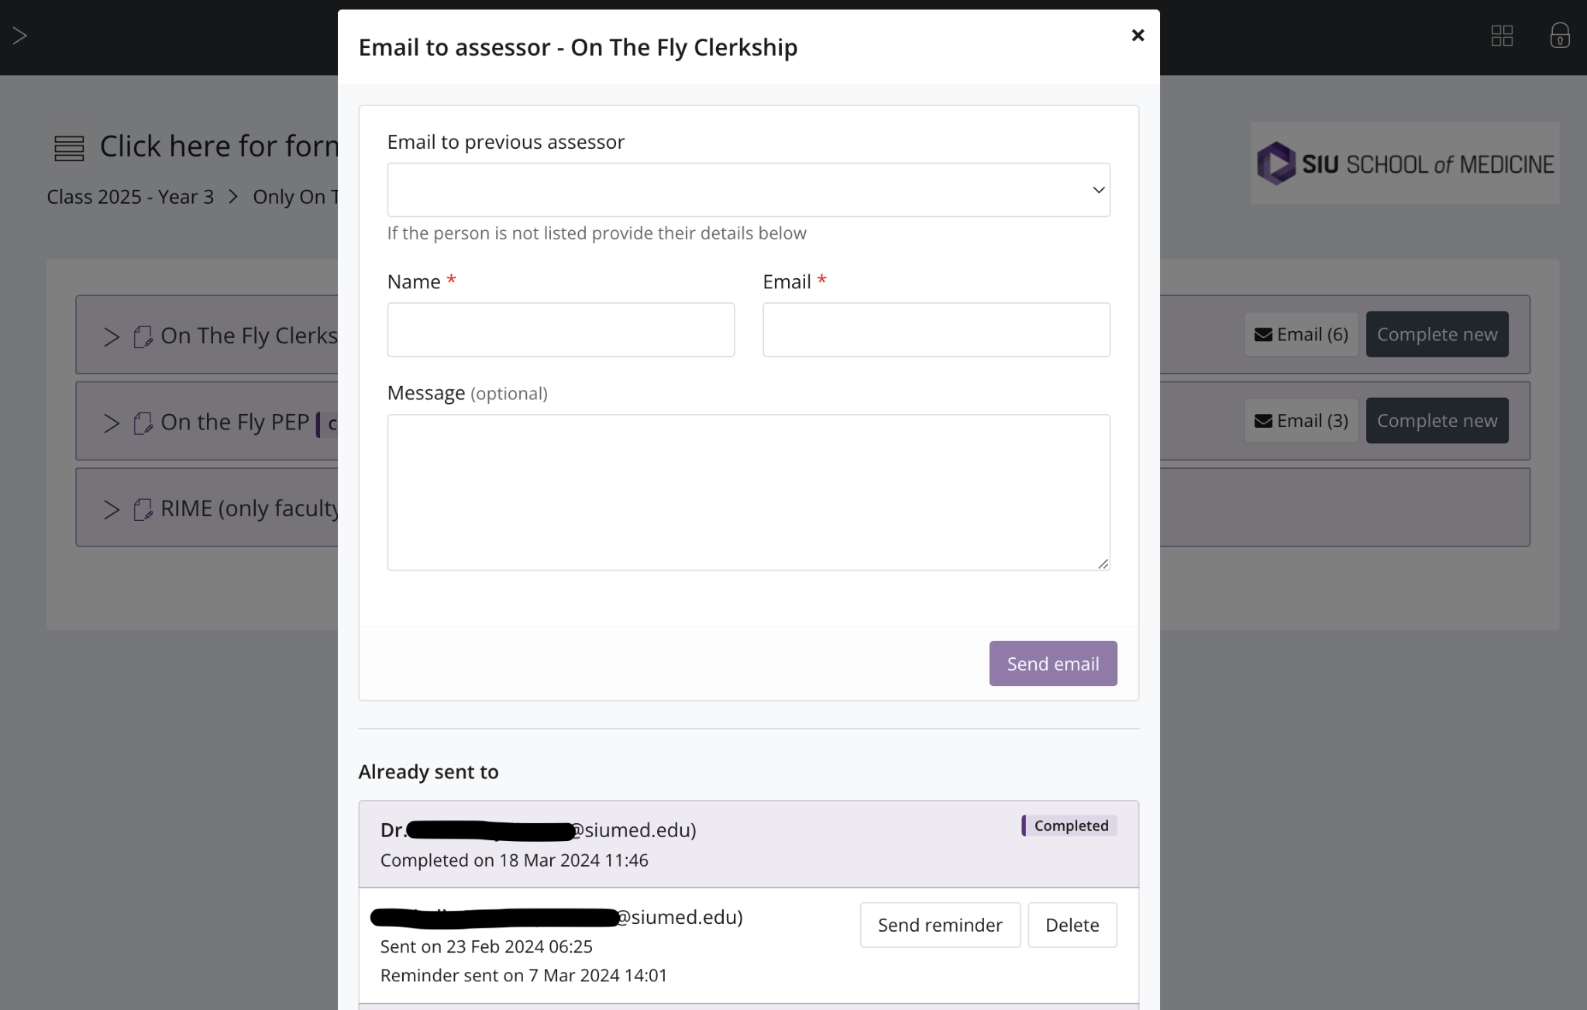
Sending a Reminder
If you click on “Email (#)”, their name should be added to the “Already sent to” list
It will indicate if they have completed the evaluation or if they could use a reminder email

Slide 20
Example On The Fly Template
Hello Dr. _____,
I worked with you on ____. Whenever you get a chance would you mind filling out this evaluation.
These were a few of the interesting learning points and patients we evaluated together:
These are some of the areas you said I did well on:
These are some of the areas you said I should work on improving:
If you have any questions, feel free to contact me.
Thanks!
Notes:
This is the template they provide for the EM Clerkship
This helps jog the memory of your evaluator
The sooner you submit an On The Fly after an encounter, the better.

Slide 21
Y2 Coachability Facilitator Sign-Up
MS4 Coachability Managers:
Bukola Ayegbusi - CRR Manager: Resiliency & Burnout***
Peyton Keller - NMB Manager: Conflict Resolution & Patient Coachability***
Brix Clayton - ERG Manager: Feedback
To be excused from your clerkship duties during these sessions, you MUST:
1) Email the Clerkship Directors/Clerkship Teams well before the clerkship starts
Indicate your plan to sign up to be a Coachability Facilitator
CRR session will be the week of 11/18/24 during Clerkship #5
NMB session will be the week of 2/3/25 during Clerkship #8
ERG session will be the week of 3/31/25 during PEP
Since the exact date/time of the session likely will not be announced prior to the start of your clerkship and potentially with short notice, inform them that the session is 1hr long at the SOM building and can occur anytime M-F between 7AM-7PM (More often in the AM or Early PM)
Ask for guidance if they have a preference or recommendation for the time of day that may be better, etc. for you to sign up for when the schedules get announced
2) Fill out a Time-Off Request Form as soon as the session date/time is announced
https://www.siumed.edu/oec/webform/time-request-form.html
You will be expected to return to your clerkship duties following your session
Do NOT sign up for a session if you know you will be out of Springfield on your Family Medicine Clerkship
This is for those of you on FM during Clerkship #5 or Clerkship #8
Notes:
*** Indicates that this session has has recently been updated and might be different than what you remember from last year
A Google Drive Sign Up Sheet will be sent out: https://docs.google.com/spreadsheets/d/19-lVAsGd47zh8UhjFYfm2Fb-q26AVzyUm14Rpvv9C3s/edit?usp=sharing

Slide 22
What questions do you have for us?

